Slide 1

Unit 5: Energy
The Transfer of Energy between the Sun, Earth’s Surface and our Atmosphere

Slide 2
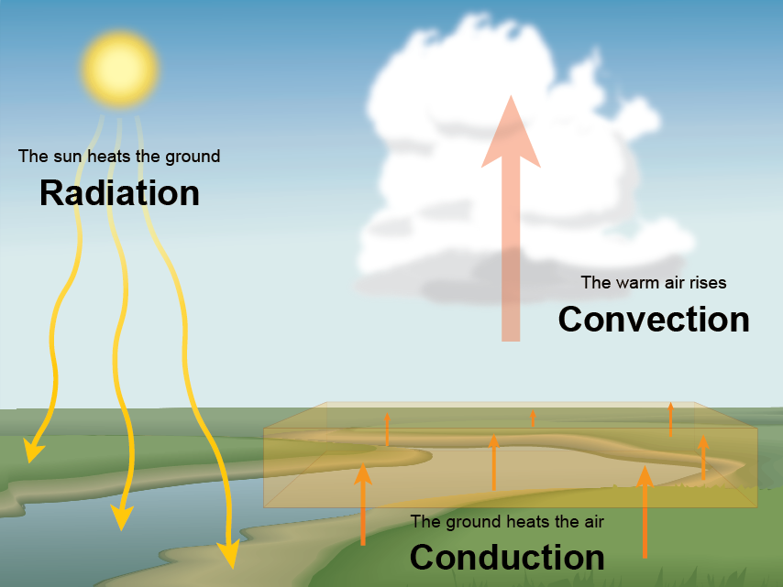
On Earth, there are three methods of heat transfer

Slide 3
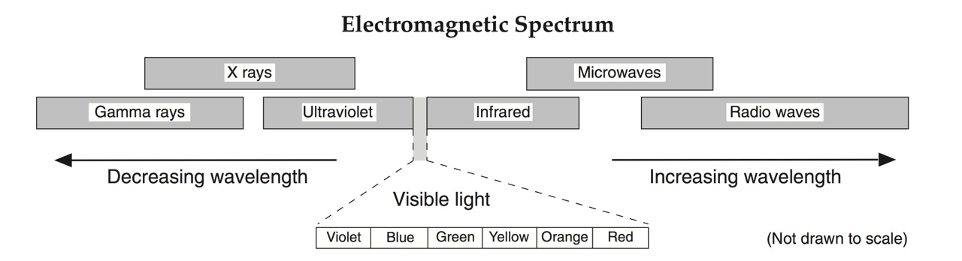
Where does Earth’s energy come from?
The temperature measured at Earth’s central core (+6000°C) is actually inferred to be hotter than the sun’s surface (~5600°C). This heat is largely due to the initial heat created from the planets formation (accretion/impacts).
MOST of Earth’s energy received at the surface is in the form of electromagnetic energy created by the Sun (ESRT pg. 14)
  Earth’s magnetosphere and atmosphere filter out most of the high energy, short wavelength radiation (x-rays, gamma rays and most UV)
  Energy that makes it to Earth’s surface is in the form of:
    Visible (ROYGBV) 44%
    Infrared (Heat) 48%
    Ultra Violet (UV) 7%

Slide 4
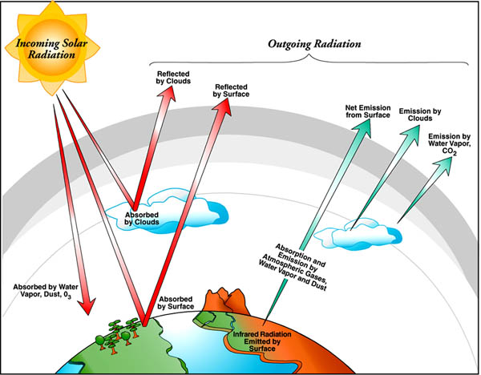
Radiation: when energy is transferred through electromagnetic waves; requires no medium and can be transferred through any state of matter.
How much energy can be absorbed by Earth’s surface depends on a few factors:
1.) The angle at which the light is received
2.)The Type Surface (medium) absorbing the radiation

Slide 5
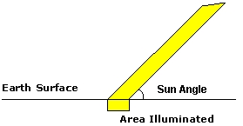
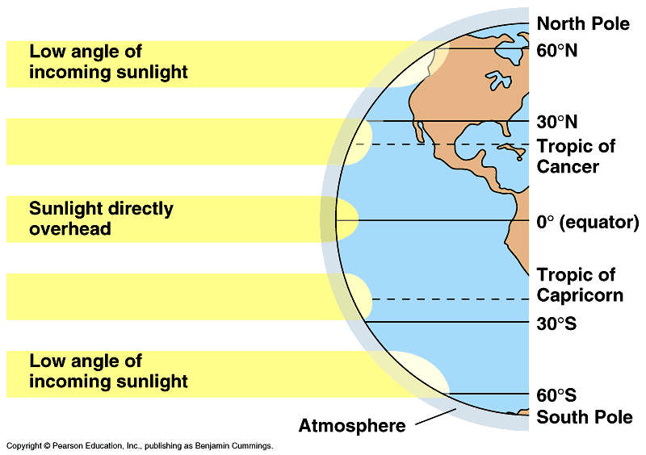
1.) The Angle of Insolation (sun’s angle):
The angle at which the sun’s rays strike the earths surface (measured from the horizon)
Because the earth’s surface is curved, all latitudes receive different angles of insolation.
The higher the angle of insolation, the more energy absorbed by earth’s surface.

Slide 6

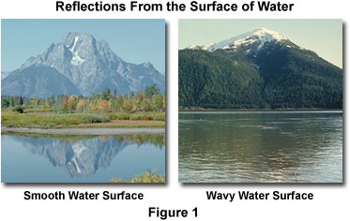
2.) The type of surface receiving the energy; Earth’s surface varies by color, texture and medium
Color- Would you rather walk barefoot on a dark asphalt surface in the middle of a hot summer day or a concrete sidewalk?
  Darker colored material will naturally absorb more solar energy compared to lighter material, but they will also cool down quicker
Texture- Does still water on a lake portraying a perfect mirrored reflection absorb more or less energy than when it’s surface is textured?
ii. Roughness or smoothness of a surface affects the amount of energy absorbed. The rougher a surface, the more energy it will absorb and the
less it will reflect.

Slide 7
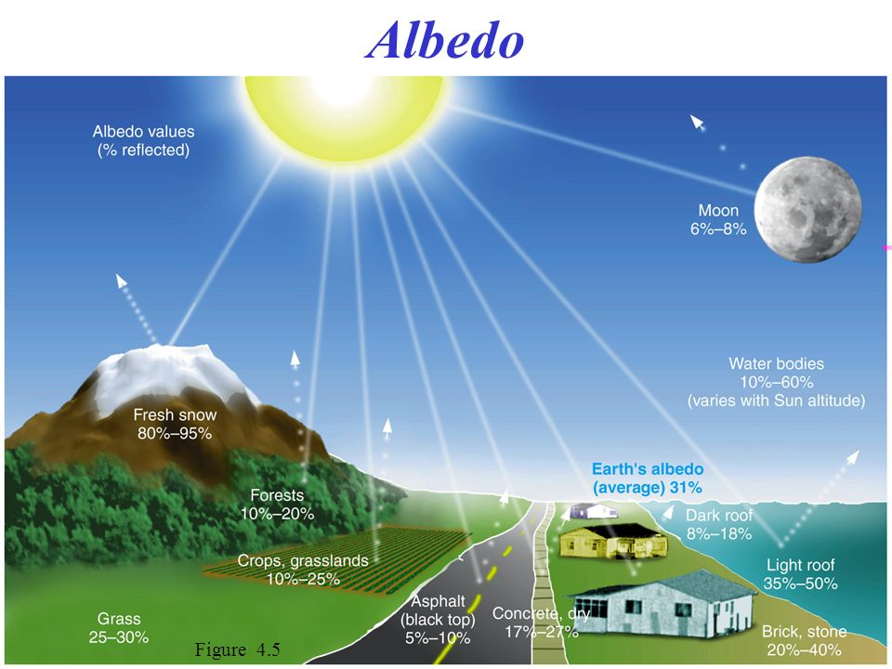
Color and texture combine to create differing amounts of reflectivity on Earth’s natural surfaces called ALBEDO
Snow can reflect up to 95% of incoming solar energy (and absorb 5%) while Asphalt will reflect only 5% (and absorb 95%)
Making a connection:
Q: If glaciers continue to melt as global temperatures rise, how may that further contribute to a global temperature change?

Slide 8
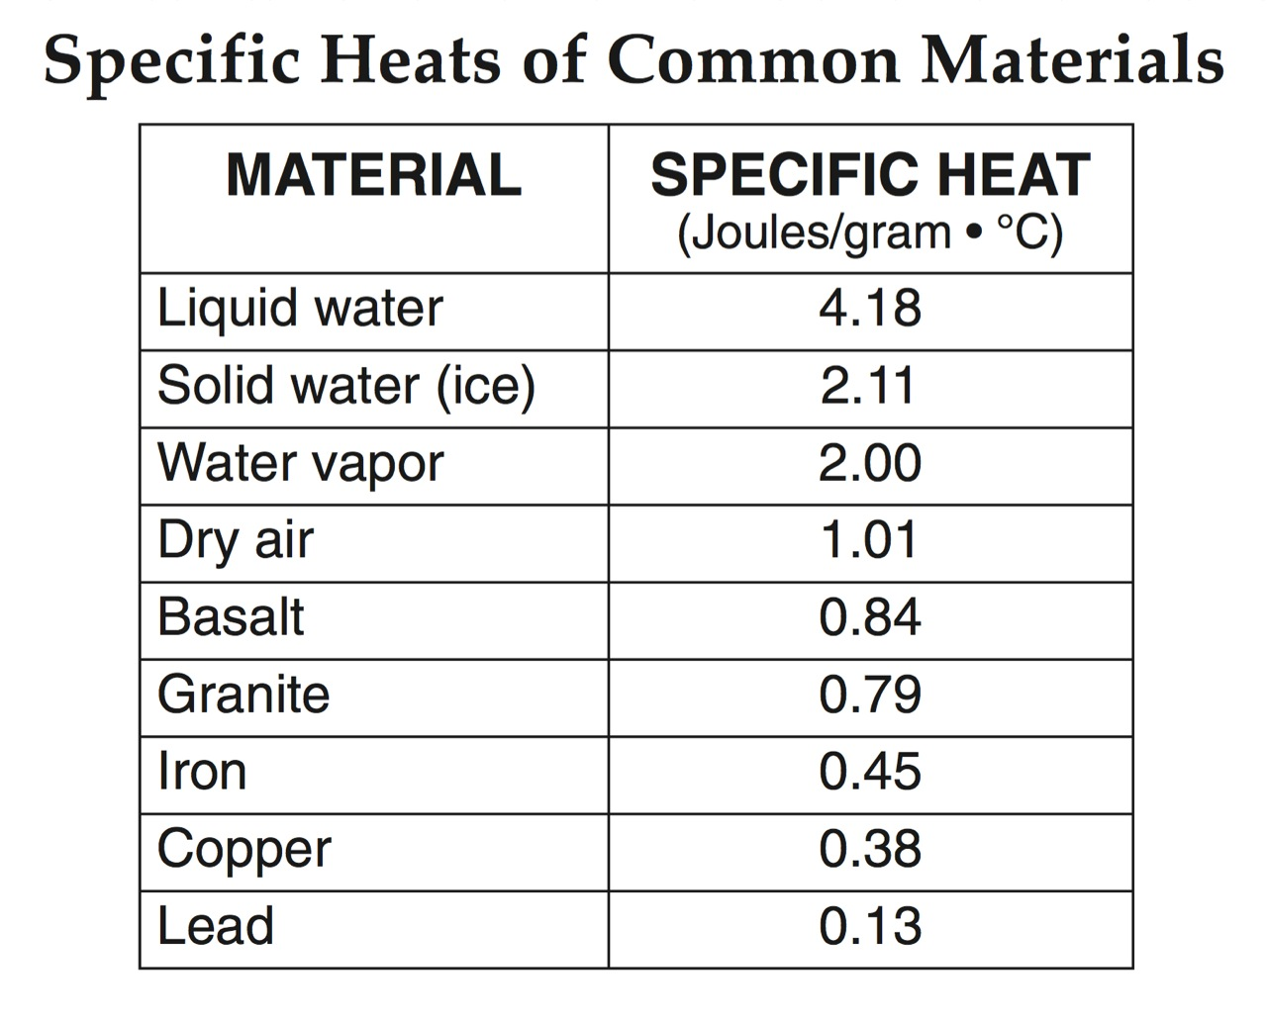
iii. The type of medium; differential heating according to specific heat (pg. 1 of ESRT)
Specific Heat- That amount of heat needed to raise the temperature of one gram (g) of a substance by one degree Celsius.
It takes 4.18 joules of energy to increase the temperature of water by 1°C but granitic rock (most continental crust) only 0.79 joules (less than 1/5 as much!)
The relationship: the greater the specific heat of a substance, the greater the resistance to heating

Slide 9
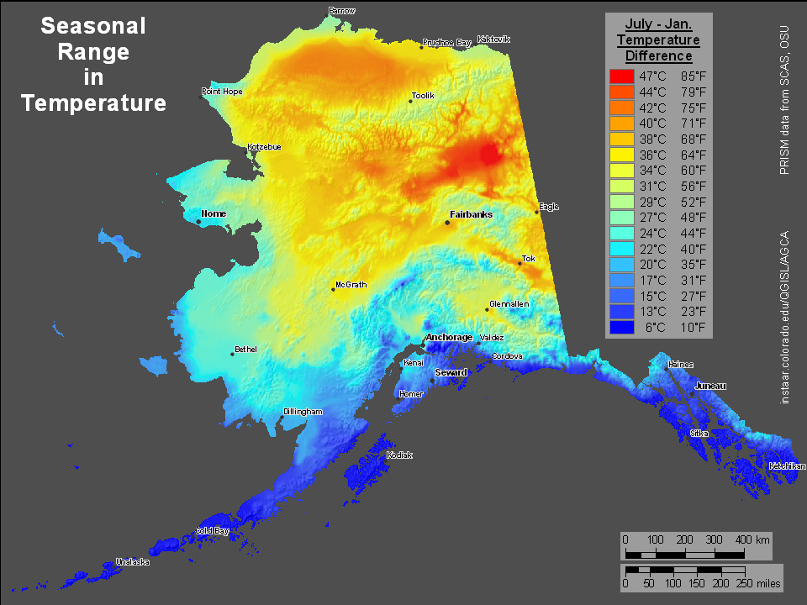
Making the connection:
Why would Alaska have a greater seasonal range of temperature in regions inland compared to its coastal locations?

Slide 10
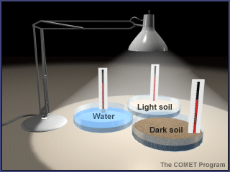
Objective: To test the amount of absorption of energy received via RADIATION with different variables
Each group will test a different variable
1.) Color of material (light/dark, or natural colors in the environment)
2.) Texture of material (rough vs. smooth)
3.) Specific Heat of Material (different substances)
Experiment Guidelines:
All materials must be measured to have the same volume when tested
All material must be exposed to radiation for the same length of time
All material must be exposed to the same angle of radiation/distance from heat source during experiment (unless you are testing angle itself)
Data must be collected in intervals over a period of 10 minutes

Slide 11
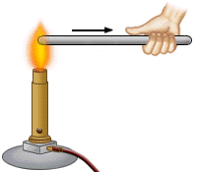
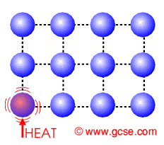
Conduction: Transfer of heat from atom to atom when vibrating atoms or molecules collide. This can take place through any state of matter
Making the connection: You are making a snowball in the winter. After rounding and compacting the ball, your hand feels virtually frozen. Why?
The hotter a molecule is the faster it vibrates

Slide 12
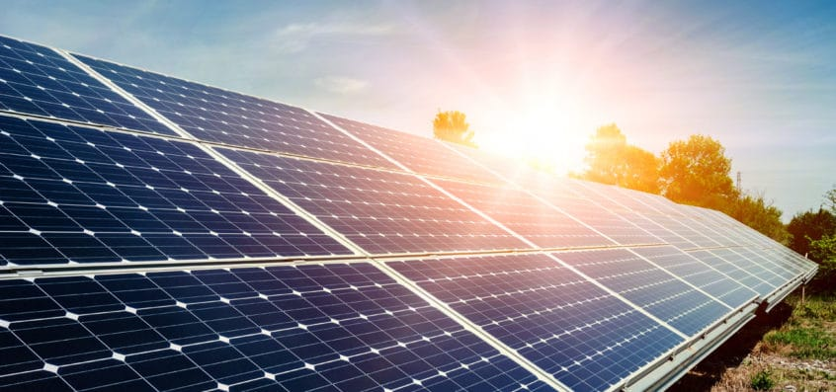
“Source to sink”
Heat transfer will only occur when two objects (or substances) have differential heating (different temperatures)
Heat will always transfer from the heat source (higher temperature) to the heat sink (lower temperature)
If not all energy is gained by the “sink” it has been lost to the environment (no transfer is 100% efficient!). All systems lose some heat energy during transfer
Ex: energy required to heat up the substance itself (like a hot pan for cooking) or energy re-radiated by the substance after it is heated (your food cooling off)

Slide 13
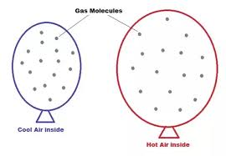

Convection: The transfer of heat energy caused by differences in density (due to differences in temperature)
Warm substances: are less dense than their cooler counterparts. This is because as a substance warms, the volume of the substance expands, due to the molecules moving further away from one another. Lower density means the substance will rise.
Cooler substances: are more dense than their warmer counterparts. This is because as a substance cools, the volume of the substance contracts, due to the molecules moving closer together. Higher density means the substance will sink.

Slide 14
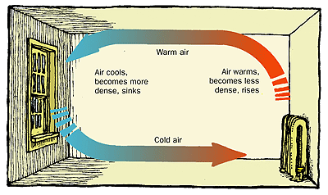
Real world connection: why do I feel drafts?

Slide 15
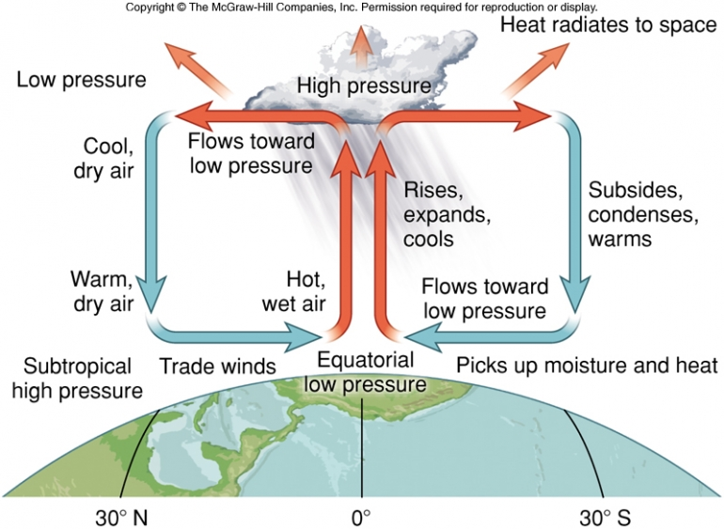
The Atmosphere and Convection
*On Earth, warm air rises and cool air sinks.
*Warmer air is less dense, and creates regions of lower pressure on earth
*Cooler air is more dense and creates regions of higher pressure

Slide 16
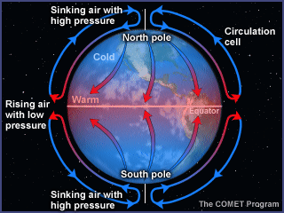
Connections to Convection on Earth: Atmospheric Circulation from the equator to the poles

Slide 17
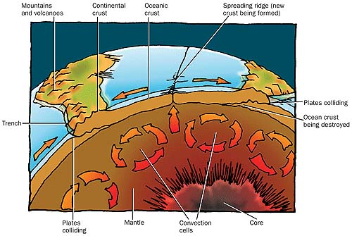
Connections to convection on Earth: Plate Tectonics

Slide 18
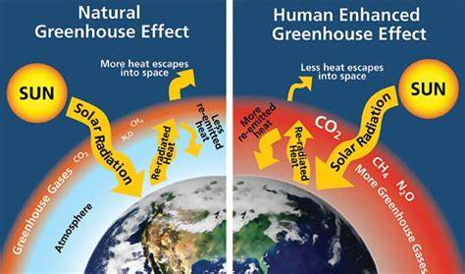

Slide 19
The Greenhouse Effect
Earth’s surface absorbs incoming short-waved ultraviolet and visible radiation as well as incoming long-wave infrared from the sun.
Once energy is absorbed, earth re-radiates this energy in the form of only long wave infrared (heat) energy. If it weren’t for greenhouse gases, the earth’s average temperature would be below freezing (-18 C/0 F).
An increase in greenhouse gases will cause global temperature averages to continue to rise, as more of earth’s outgoing long-wave terrestrial radiation becomes trapped by our atmosphere.

